Slide 1

Machine Learning Methods for Early Prediction of End-of-Life for Lithium-ion Batteries
James Chapman
CIS 732 Machine Learning – Term Project
Kansas State University
jachapman@ksu.edu

Slide 2
Overview
Lithium-Ion Batteries Introduction
The Battery Data Set
Severson et al. 2019 (MIT)
2 types of features (1D & 2D)
Machine Learning Models
Support Vector Regression (SVR)
Multilayer Perceptron (MLP)
Long-Short-Term-Memory RNN (LSTM)
Convolutional Neural Network (CNN)
Results & Conclusion

Slide 3
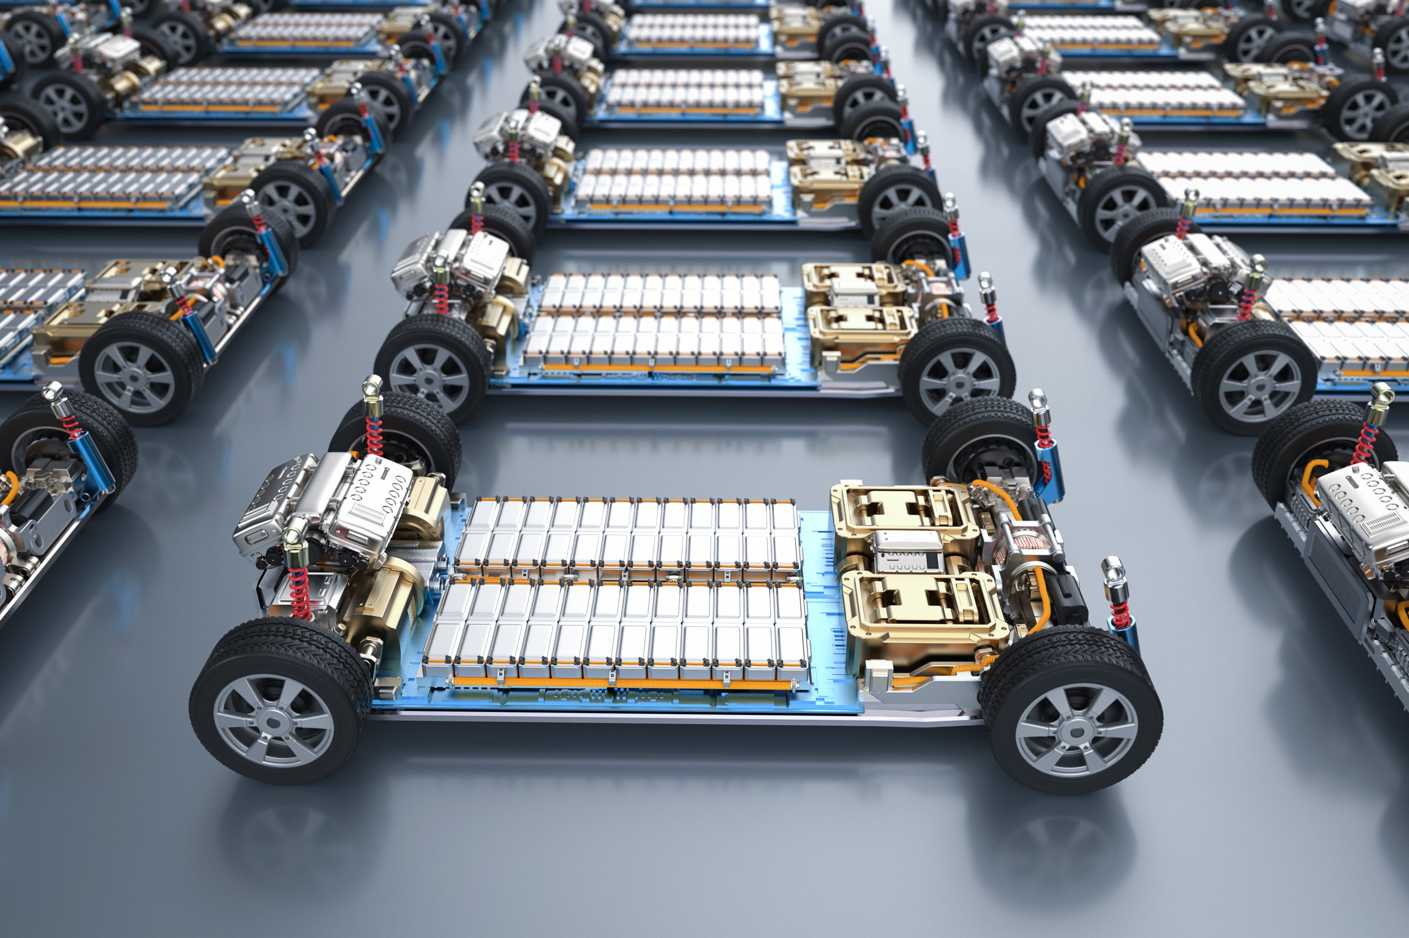
Lithium-Ion Batteries
Strong future
Environmental concerns / Renewability
Electric vehicles
Consumer electronics
Grid scale support
End-of-life
No longer capable of 80% capacity
Notes:
I think everybody knows that lithium-ion batteries is a growing technology with a big future. And that batteries have a shelf life.

Slide 4
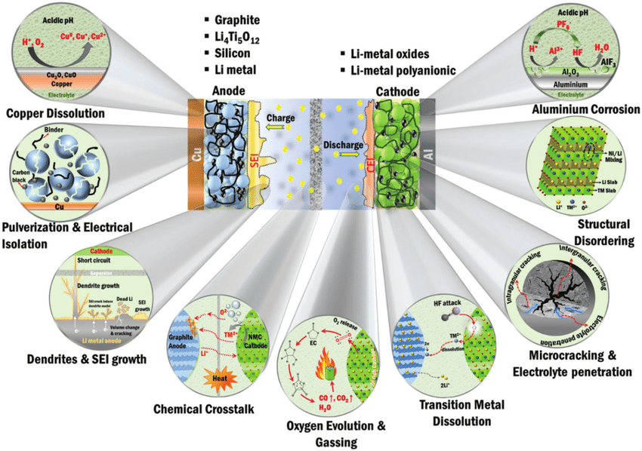
Battery Degradation
Complex electrochemical mechanisms
Highly irregular behavior
End-of-life
Wide range/high variability
Hard to predict
Severe consequences
Overview of the major degradation mechanisms
Narayan, R., Laberty‐Robert, C., Pelta, J., Tarascon, J. M., & Dominko, R. (2021). Self‐Healing: An emerging technology for next‐generation smart batteries. Advanced Energy Materials, 12(17), 2102652. https://doi.org/10.1002/aenm.202102652
Notes:
I think everybody knows that lithium-ion batteries is a growing technology with a big future. And that batteries have a shelf life.

Slide 5
Data-driven modeling
Mechanism-Agnostic
Black box
Machine learning & artificial intelligence
Captures behaviors and patterns
Harness information
Data sparsity
Expensive
Experiments take months
Notes:
I think everybody knows that lithium-ion batteries is a growing technology with a big future. And that batteries have a shelf life.

Slide 6
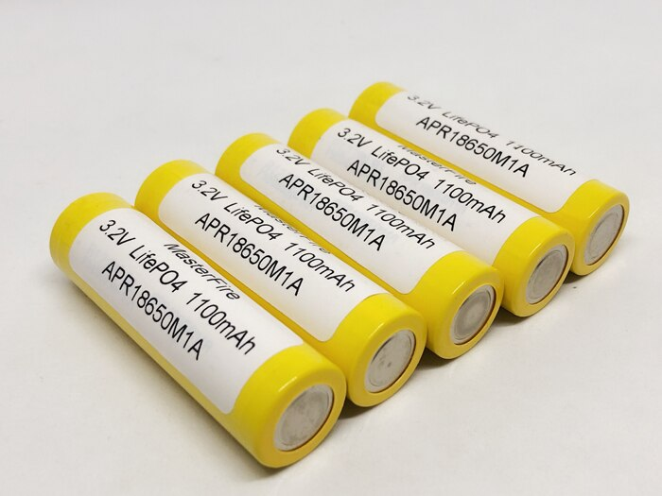
The Battery Data Set
Severson et al. 2019 (MIT)
Largest open-source data set of its kind
“Cycles”
Charged/Discharged until end-of-life
Variety of conditions & collect data
Severson, K. A., Attia, P. M., Jin, N., Perkins, N., Jiang, B., Yang, Z., Chen, M. H., Aykol, M., Herring, P. K., Fraggedakis, D., Bazant, M. Z., Harris, S. J., Chueh, W. C., & Braatz, R. D. (2019). Data-driven prediction of battery cycle life before capacity degradation. Nature Energy, 4(5), 383–391. doi.org/10.1038/s41560-019-0356-8

Slide 7
Severson et al. 2019
End-of-life
No longer capable of 80% capacity
Integer ( ̴ 300-2500)
Number of “cycles”
Target of machine learning ( y )
GOAL
Predict end-of-life
Data from first 100 cycles (or less)
Notes:
I think everybody knows that lithium-ion batteries is a growing technology with a big future. And that batteries have a shelf life.

Slide 8
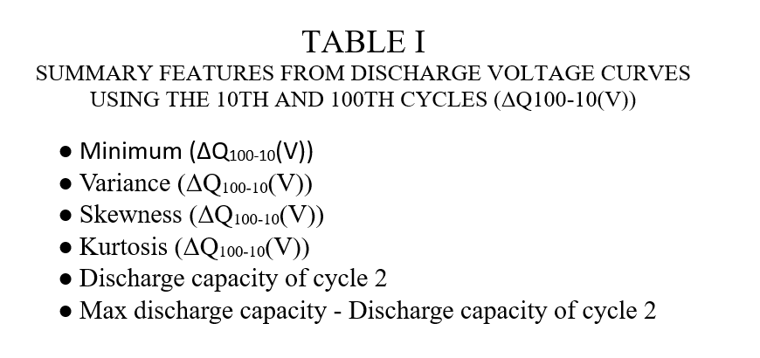
Tabular Data
Used in original paper
Calculated summary statistics
“1-dimensional”
“FULL” feature set
10 features
“DISCHARGE” feature set
6 features
Using only discharge capacity-voltage data
Notes:
I think everybody knows that lithium-ion batteries is a growing technology with a big future. And that batteries have a shelf life.

Slide 9
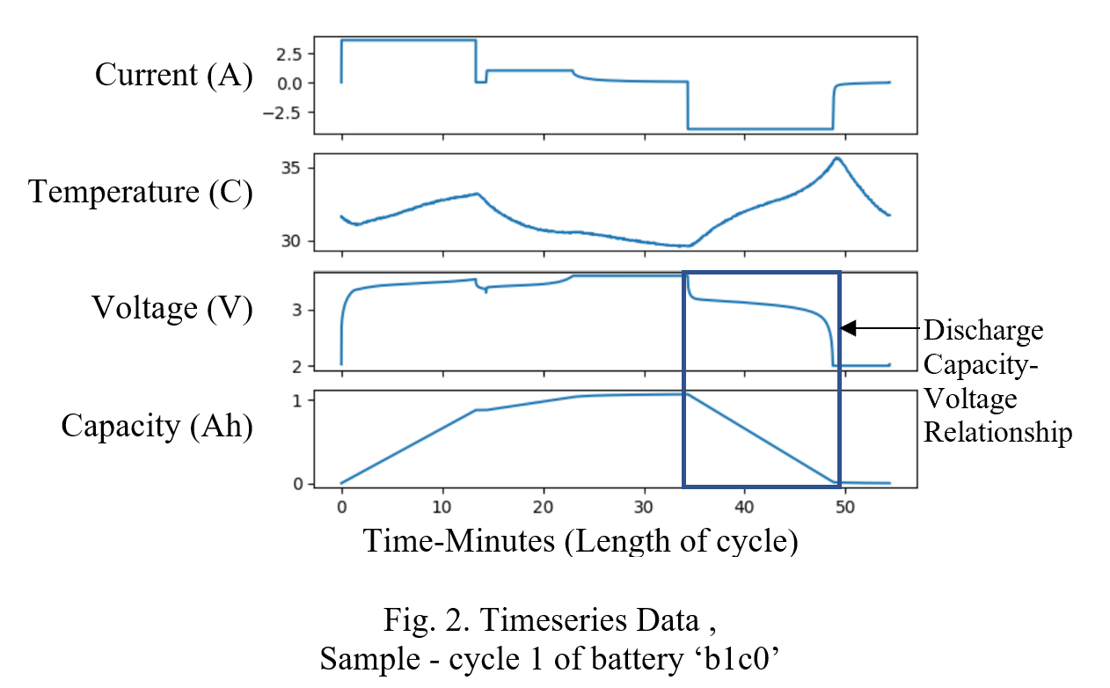
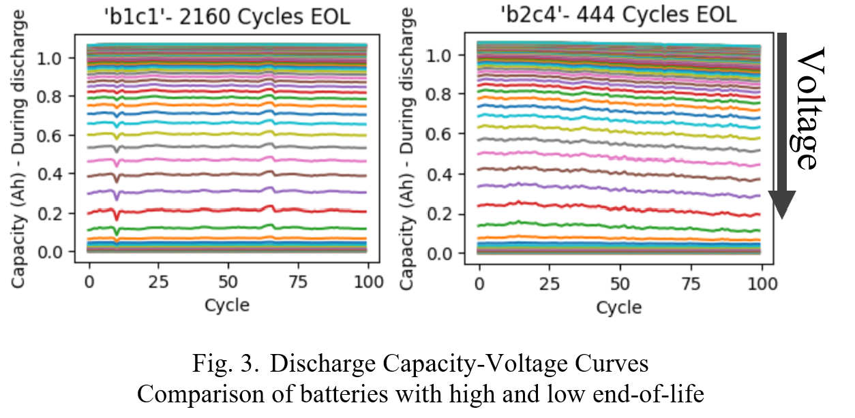
Discharge Capacity-Voltage Data
Capacity values (Ah) during “discharge”
Interpolated at 100 evenly spaced voltages (3.5V-2V)
Notes:
I think everybody knows that lithium-ion batteries is a growing technology with a big future. And that batteries have a shelf life.

Slide 10
Discharge Capacity-Voltage Data
Two-dimensional
99 cycles X 100 voltages
(skip cycle 1)
9900 capacities (Ah) per battery
Used in follow-up paper
Attia et al.
(and other papers)
 | Cycle 2 | Cycle 3 | … | Cycle 100
3.5 V
3.485 V
…
2 V
100 evenly spaced voltages
Notes:
I think everybody knows that lithium-ion batteries is a growing technology with a big future. And that batteries have a shelf life.

Slide 11
Machine Learning Models
Tabular data (1D)
Support Vector Regression (SVR)
Multilayer Perceptron (MLP)
Discharge capacity-voltage data (2D)
Long-Short-Term-Memory RNN (LSTM)
Convolutional Neural Network (CNN)

Slide 12
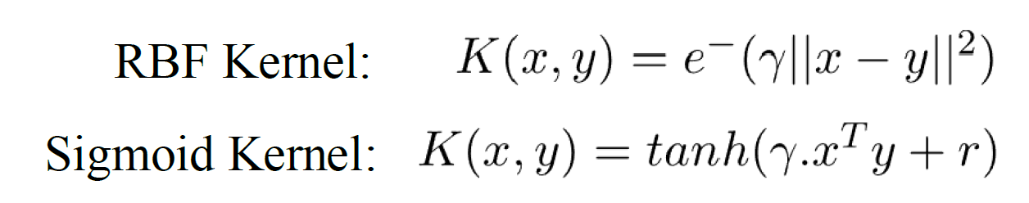
Support Vector Regression (SVR)
SVM- Projection to higher dimensional feature space
Kernel (Sigmoid, RBF, etc.)
Hyperplane ► real value (Regression)
Hyperparameters (cross-validation)
Epsilon (margin)
C (L2 regularization)
Gamma
Notes:
I think everybody knows that lithium-ion batteries is a growing technology with a big future. And that batteries have a shelf life.

Slide 13
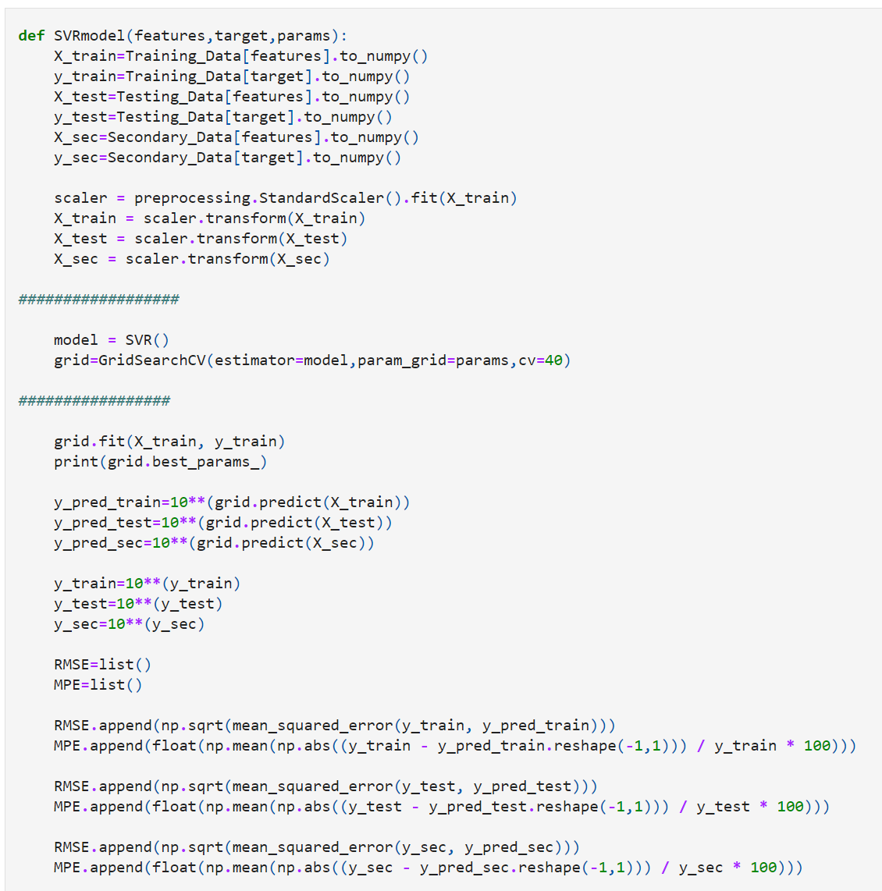
SVR
Code
sklearn.svm.SVR
Notes:
I think everybody knows that lithium-ion batteries is a growing technology with a big future. And that batteries have a shelf life.

Slide 14
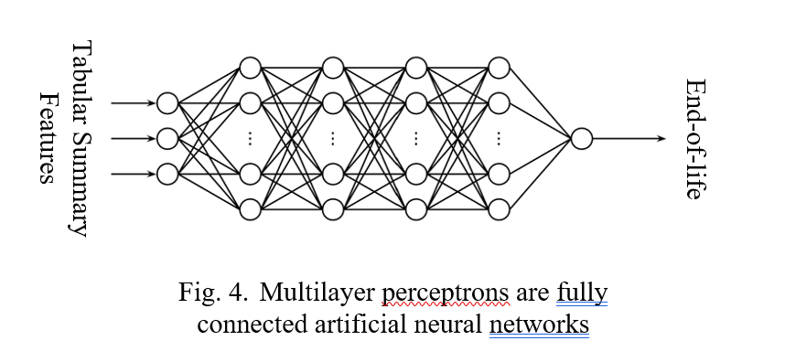
Multilayer Perceptron (MLP)
Neural network for tabular data
Nonlinear activation
Relu
Optimization
Adaptive momentum
Regularization
L2 (alpha)
Notes:
I think everybody knows that lithium-ion batteries is a growing technology with a big future. And that batteries have a shelf life.

Slide 15
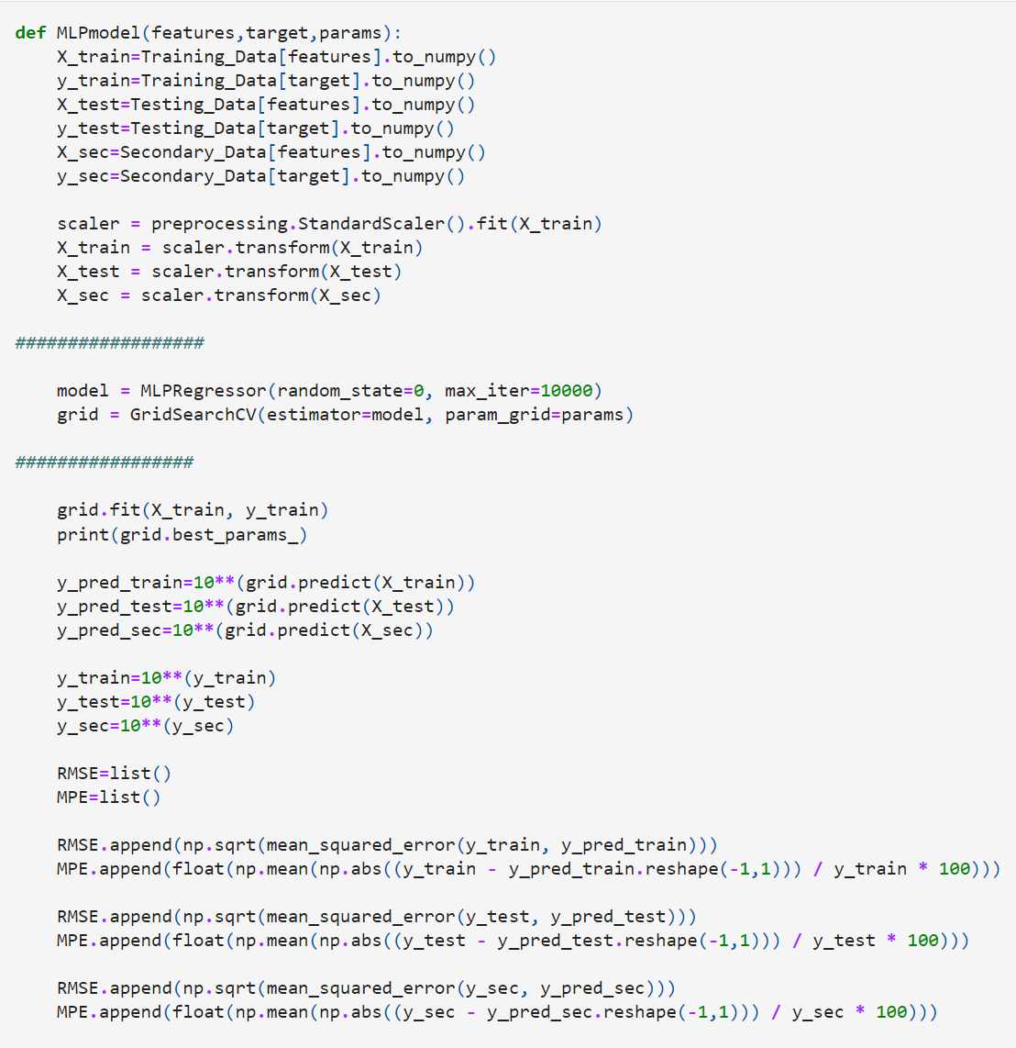
MLP
Code
sklearn.neural_network
MLPRegressor
Notes:
I think everybody knows that lithium-ion batteries is a growing technology with a big future. And that batteries have a shelf life.

Slide 16
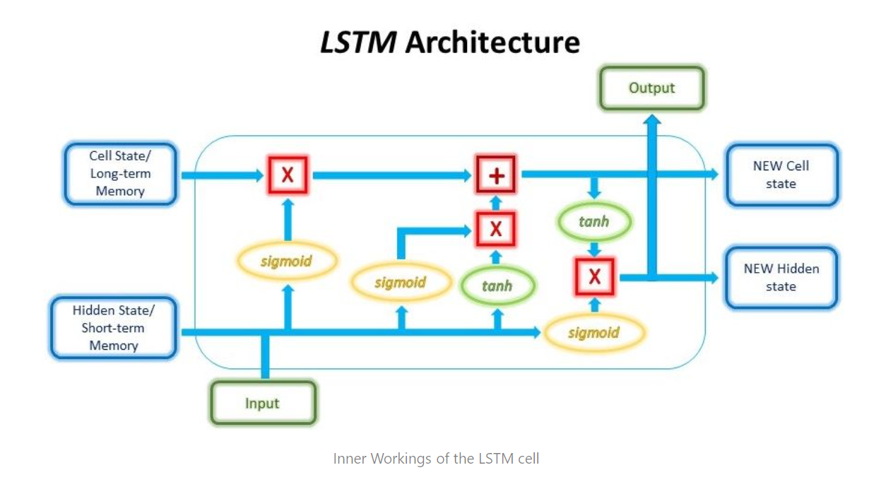
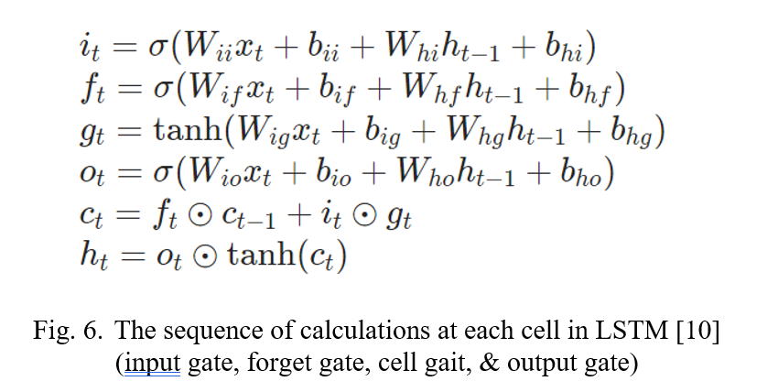
Long-Short-Term-Memory RNN (LSTM)
Timeseries data
Cell state
Hidden state
Notes:
I think everybody knows that lithium-ion batteries is a growing technology with a big future. And that batteries have a shelf life.

Slide 17
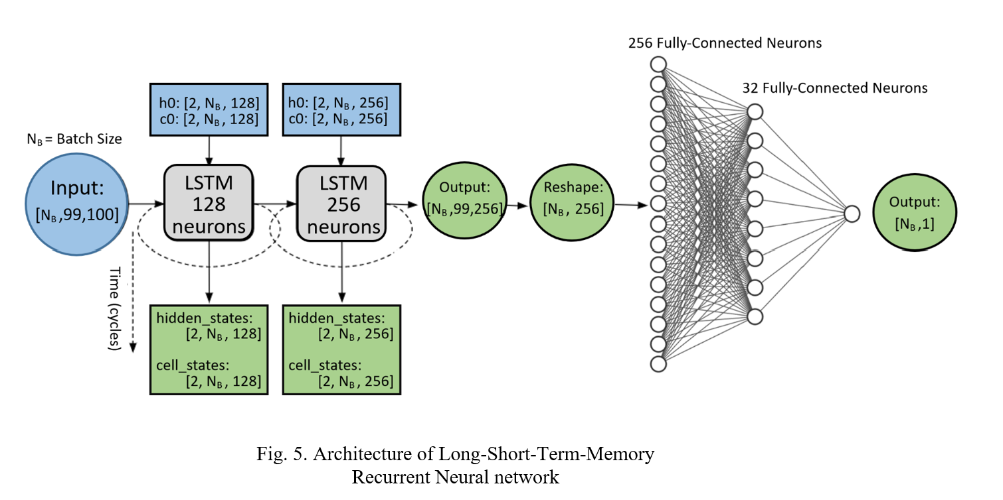
Long-Short-Term-Memory RNN (LSTM)
Notes:
I think everybody knows that lithium-ion batteries is a growing technology with a big future. And that batteries have a shelf life.

Slide 18
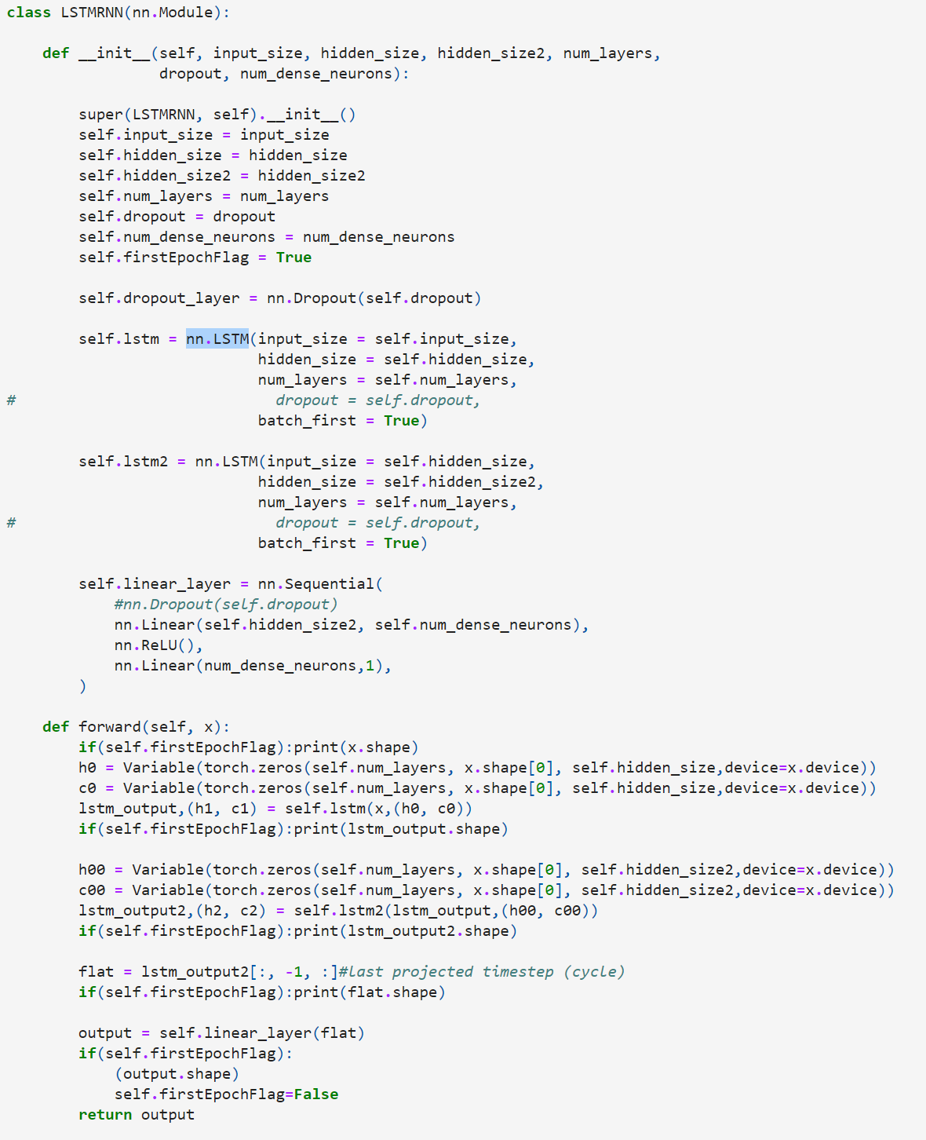
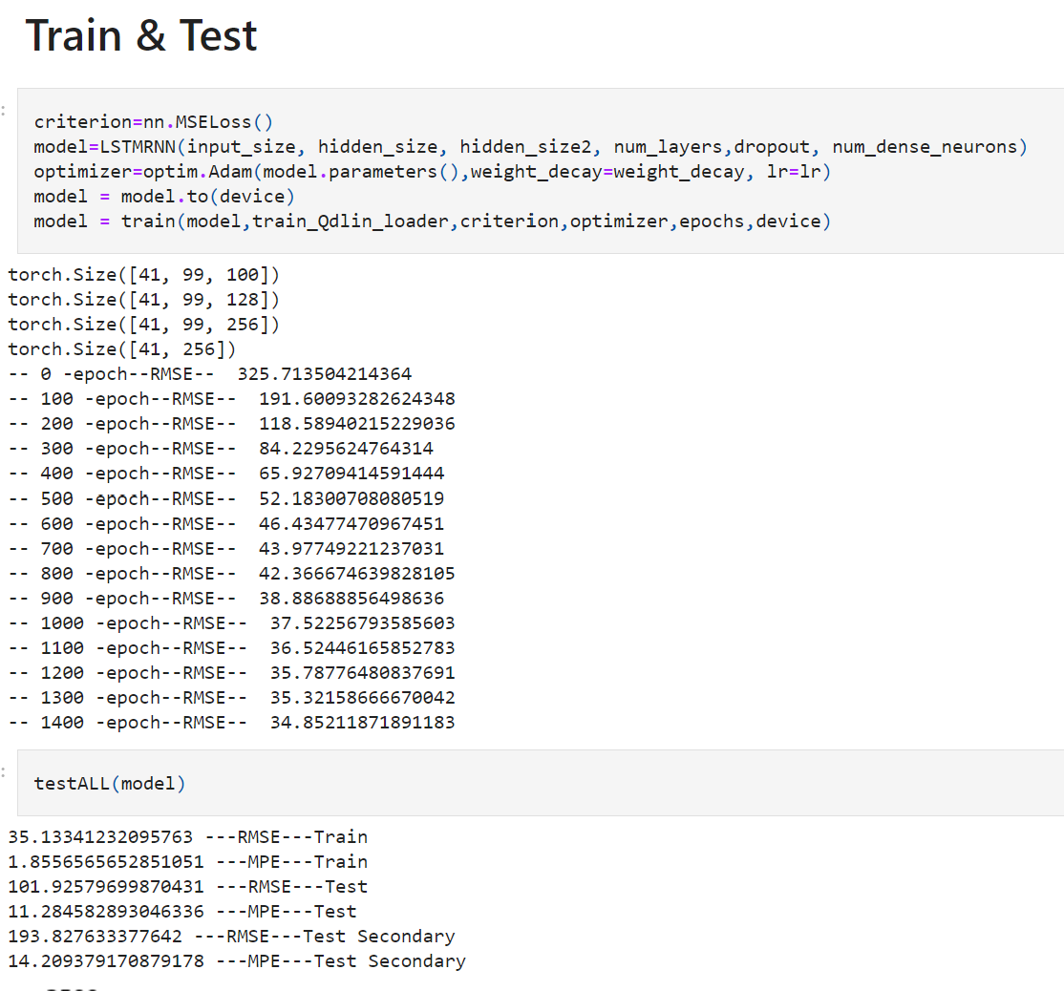
LSTM
Pytorch
torch.nn.LSTM
Notes:
I think everybody knows that lithium-ion batteries is a growing technology with a big future. And that batteries have a shelf life.

Slide 19
Convolutional Neural Network (CNN)
Convolution layers
Max Pool layers
Fully connected layers
Discharge capacity-voltage data
Two-dimensional (99X100)
Tabular summary data (discharge features)
- 6 features
Notes:
I think everybody knows that lithium-ion batteries is a growing technology with a big future. And that batteries have a shelf life.

Slide 20
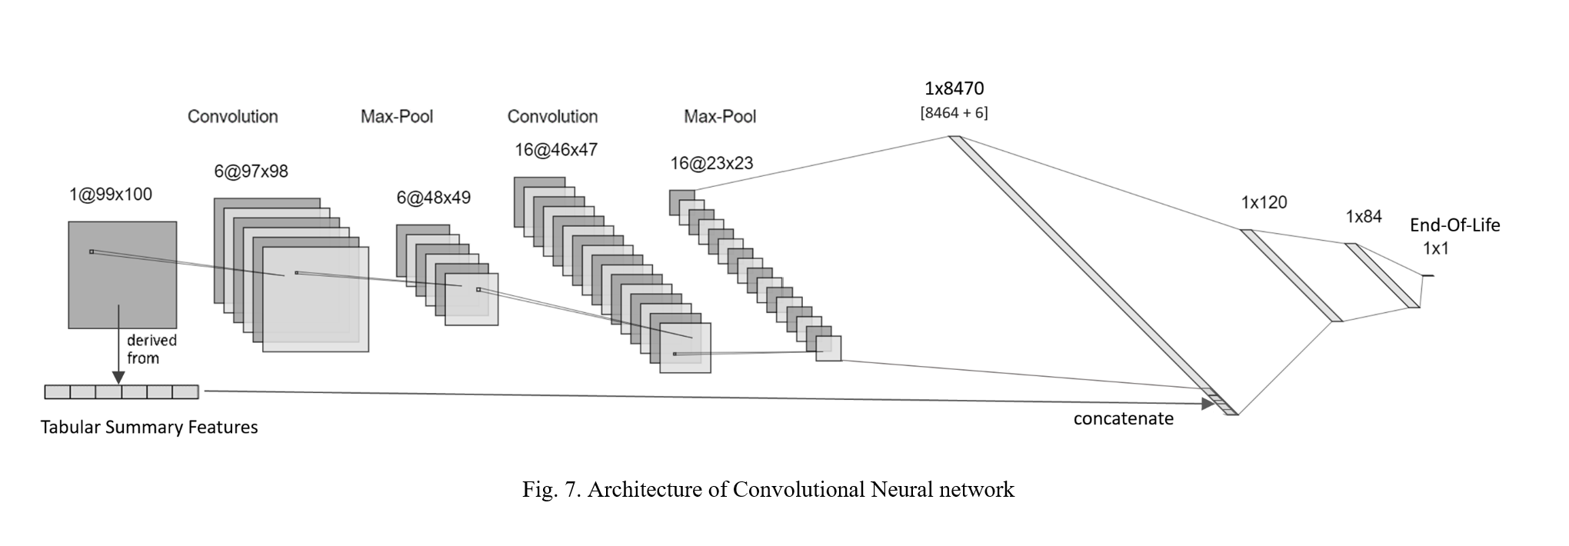
Convolutional Neural Network (CNN)
Notes:
I think everybody knows that lithium-ion batteries is a growing technology with a big future. And that batteries have a shelf life.

Slide 21
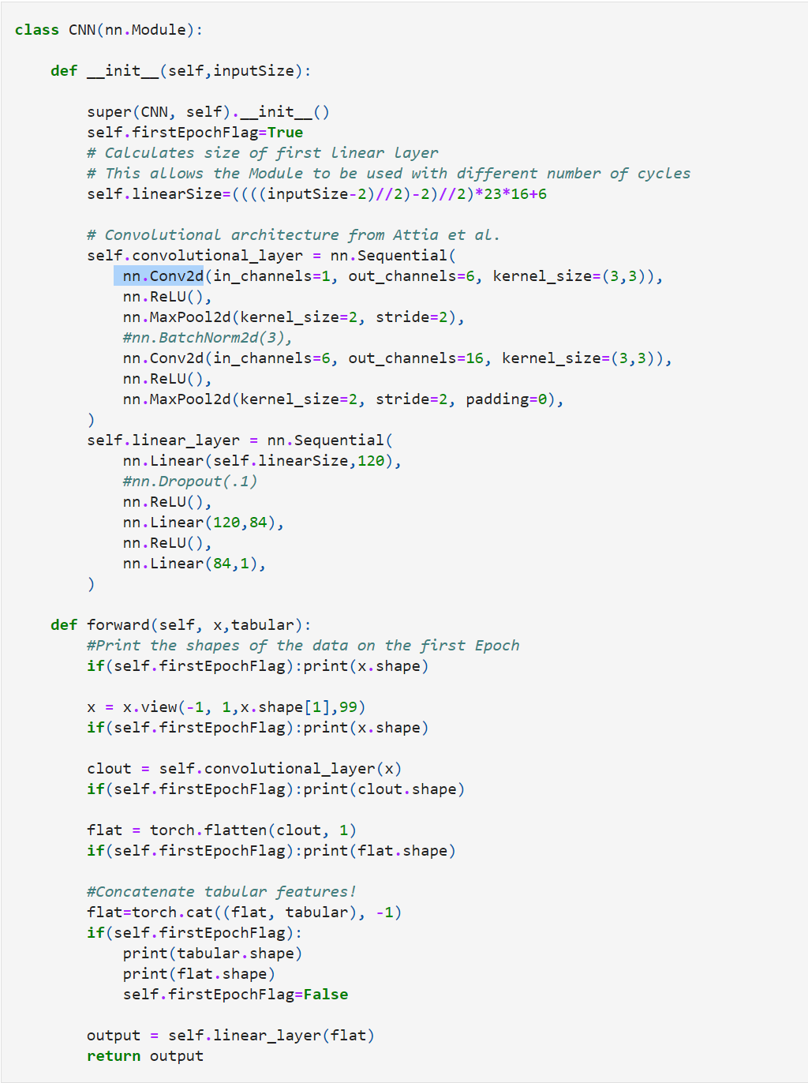
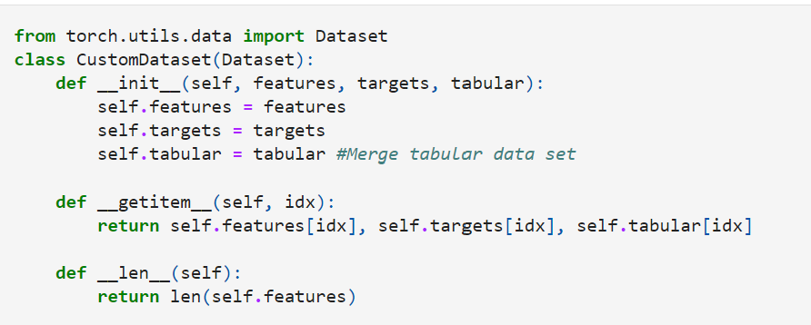
CNN
Pytorch
torch.nn.Conv2d
Notes:
I think everybody knows that lithium-ion batteries is a growing technology with a big future. And that batteries have a shelf life.

Slide 22
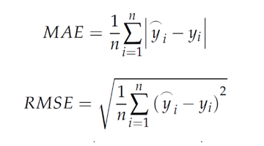
Results & Conclusion
RMSE & MAE
LSTM/CNN
Repeat training/testing
60 cycles
40 cycles

Slide 23
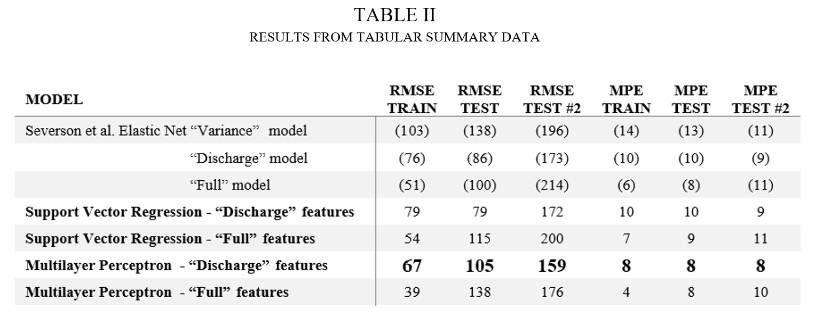
Summary data results
Notes:
I think everybody knows that lithium-ion batteries is a growing technology with a big future. And that batteries have a shelf life.

Slide 24
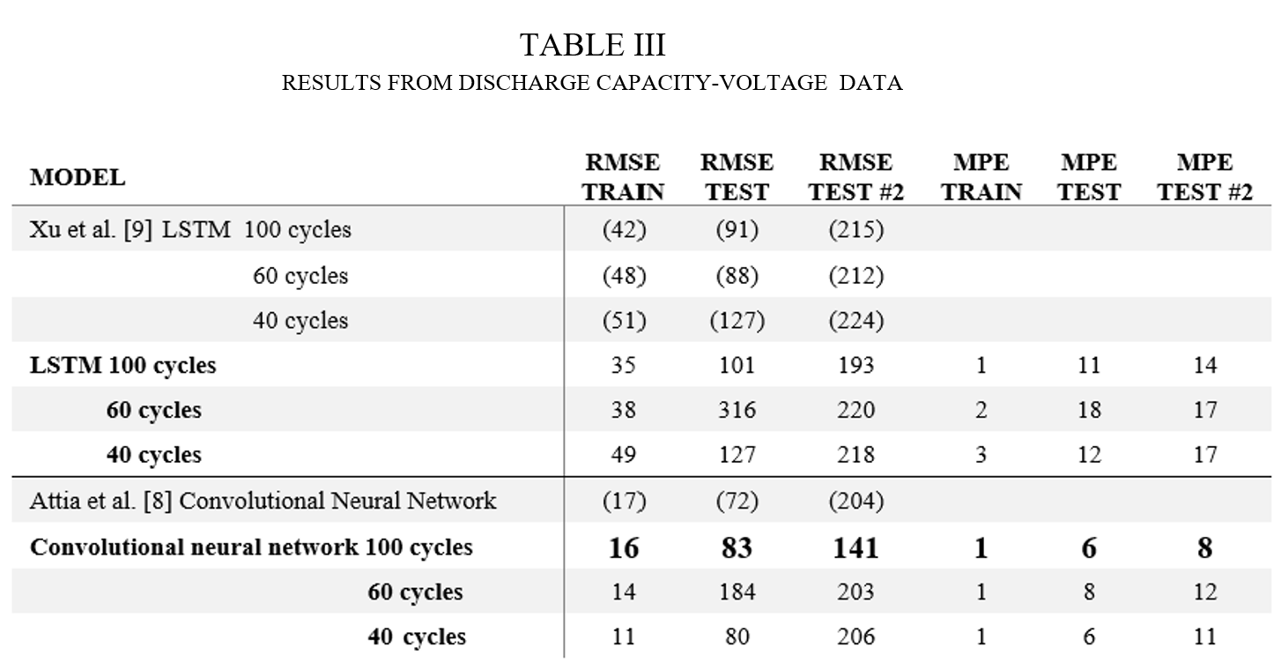
Discharge capacity-voltage data results
Notes:
I think everybody knows that lithium-ion batteries is a growing technology with a big future. And that batteries have a shelf life.

Slide 25
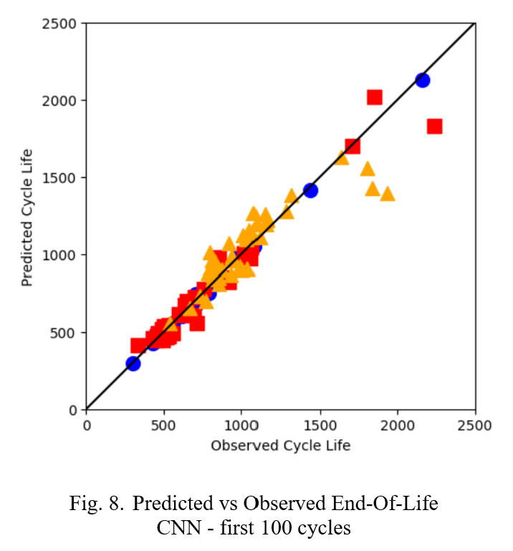
Discharge capacity-voltage data results
Convolutional neural network (100 cycles)
Best model
Notes:
I think everybody knows that lithium-ion batteries is a growing technology with a big future. And that batteries have a shelf life.

Slide 26
Discussion
Overfitting
Notes:
I think everybody knows that lithium-ion batteries is a growing technology with a big future. And that batteries have a shelf life.

Slide 27
Future work
Use more data
Voltage
Current
Temperature
Internal resistance
Trade-off
Capacity data is “free”
Notes:
I think everybody knows that lithium-ion batteries is a growing technology with a big future. And that batteries have a shelf life.

Slide 28
Machine Learning Methods for Early Prediction of End-of-Life for Lithium-ion Batteries
James Chapman
CIS 732 Machine Learning – Term Project
Kansas State University
jachapman@ksu.edu

